Slide 1
Clean Air Day 2021
People-Friendly Streets Competition

Slide 2
What is Clean Air Day?
Clean Air Day focuses on awareness to air pollution and how it can be improved.
Notes:
(27% of total UK greenhouse gas emissions in 2019). Other sources of air pollution include energy production, agriculture, industry and residential homes.
2019 UK greenhouse gas emissions: summary (publishing.service.gov.uk)

Slide 3
https://www.youtube.com/watch?v=FJg9-wpCazM

Slide 4
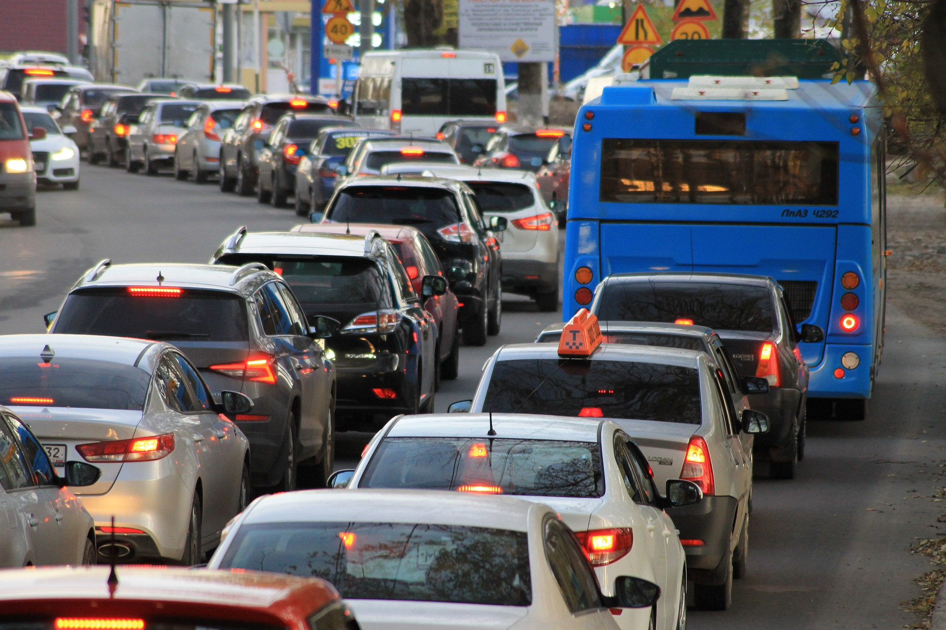
What is the main source of air pollution in the UK?
Transport!
27% of total UK greenhouse gas emissions in 2019 came from vehicles!
Notes:
(27% of total UK greenhouse gas emissions in 2019). Other sources of air pollution include energy production, agriculture, industry and residential homes.
2019 UK greenhouse gas emissions: summary (publishing.service.gov.uk)

Slide 5
What types of air pollutants do
petrol and diesel road vehicles release?
Greenhouse gases
such as carbon dioxide (CO₂).
Gases that are bad for our health
like nitrogen dioxide (NO₂)
Particulate matter (PM)
invisible tiny dust particles in the smoke
from exhaust pipes, and from the wear and
tear of tyres and brakes
(also released by electric cars!)
Notes:
How our daily travel harms the planet - BBC Future

Slide 6
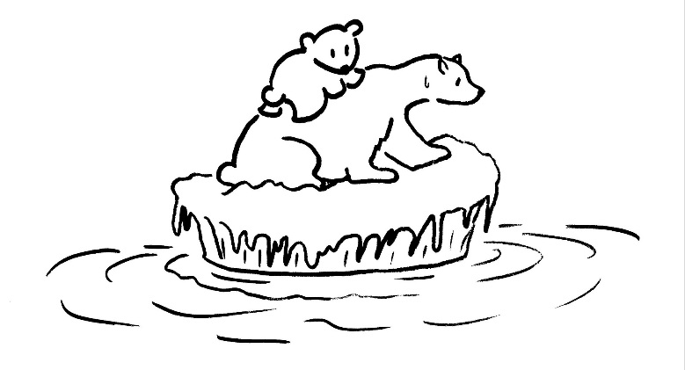
Why is air pollution a problem?
It is causing the climate emergency!
The greenhouse gases produced by our road traffic are causing our planet to warm up.
Climate change is
warming the oceans and damaging coral reefs
melting the ice sheets and harming many Arctic and Antarctic animals
causing more forest fires, droughts and floods which harms wildlife and people
Notes:
Australia floods: Saving a home from fires only to lose it in floods - BBC News
Burning fossil fuels like oil, coal and gas creates greenhouse gases.
2019 UK greenhouse gas emissions: summary (publishing.service.gov.uk)
Greenhouse gases are also produced by heating and cooking in our homes, industry, farming, waste management and deforestation

Slide 7
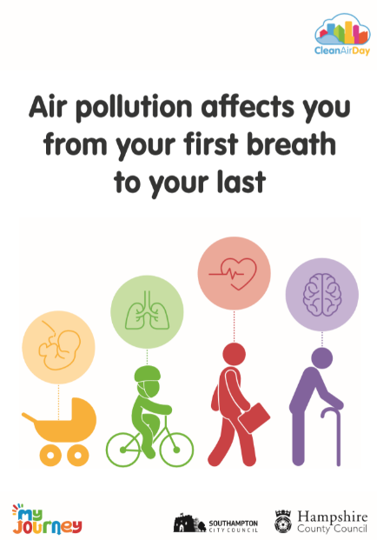
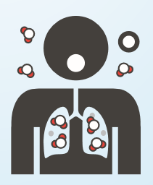
Why is air pollution bad for our health?
Breathing high levels of air pollution damages our lungs and hearts.
It is especially harmful for the young and old and people with breathing problems such as asthma.
Notes:
Every breath we take: the lifelong impact of air pollution | RCP London

Slide 8
Why is it good to walk, scoot or cycle?
Free exercise!
It makes our bodies stronger and fitter.
It makes us healthier.
It helps us to concentrate and to learn.
It makes us happier.
Notes:
Young people are recommended to have 60 minutes of physical activity each day.
Adults are recommended to have 150 minutes per week.
Better physical and mental health – people who are physically active found to have 27% fewer days off sick from work.
Physical activity guidelines: infographics - GOV.UK (www.gov.uk)

Slide 9
Cars take up so much space on our streets!
For most of the time, cars are parked and not moving.
Cars usually carry only 2 people or fewer and take up the same space on the roads as
5 people cycling or
20 people walking.
Notes:
Walking and cycling: the economic benefits (tfl.gov.uk)
Spaced Out parking report (racfoundation.org)
Think of all the space that would be freed up if we reduced the number of cars on our roads.

Slide 10
What about using buses or trains?
One bus can carry the same number of passengers as 30 - 40 cars.
Notes:
Efficiency Master - a Comparison of Different Modes of Transportation (bikecitizens.net)
Coronavirus (COVID-19): safer travel guidance for passengers - GOV.UK (www.gov.uk)

Slide 11
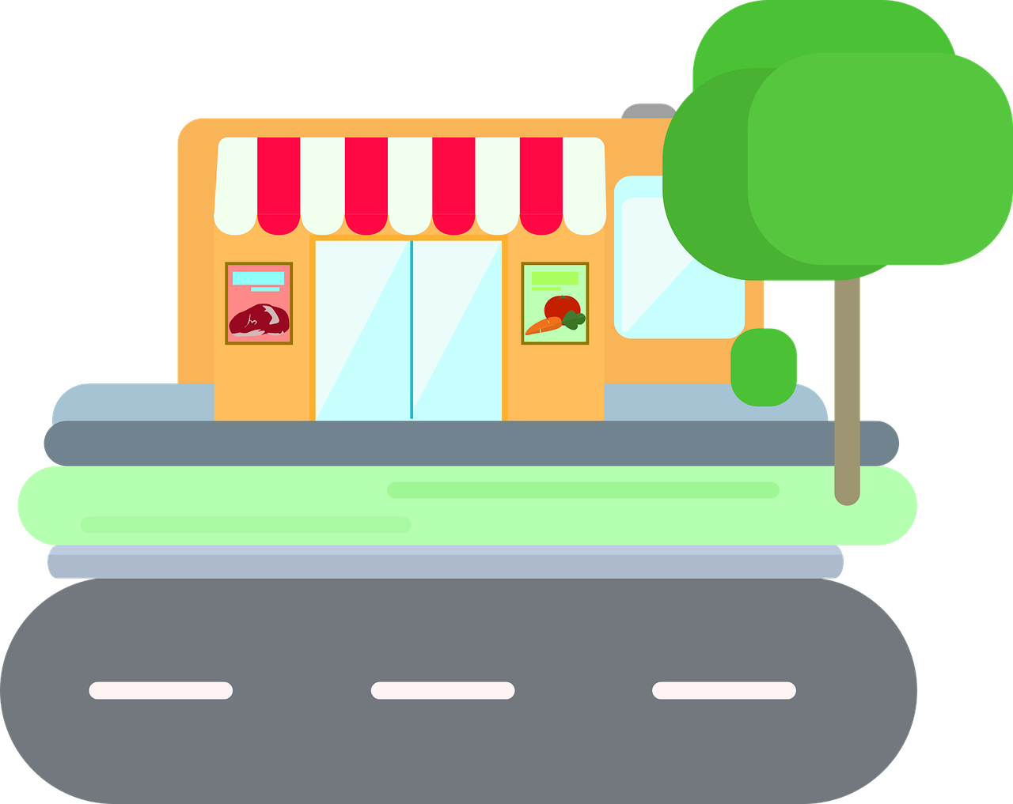
What if we could get everything we need to live without driving?
‘15 minute cities’ and
‘20 minute neighbourhoods’
are being created in places like Paris and Melbourne.
In these areas people’s homes are close to shops, schools, doctors, workplaces and parks.
They can reach all their needs without having to use a car.
Notes:
What is a ‘15-minute city’? – YouTube

Slide 12
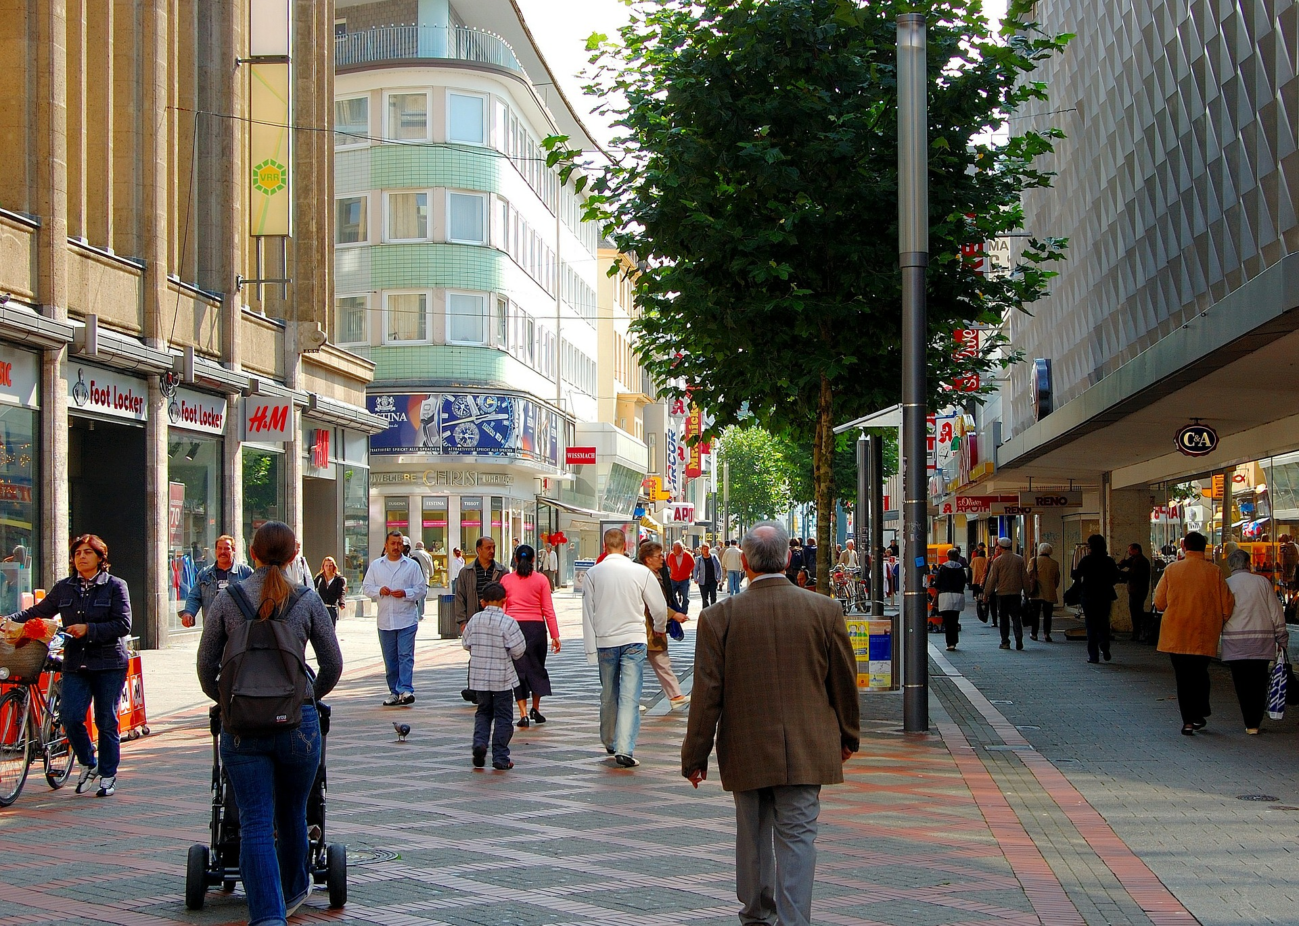
In which street would you prefer to walk or cycle?
Less traffic makes more space for people and cleaner air!
When cycling or walking in busy streets, you’ll often breathe cleaner air rather than sitting inside cars where the dirty air gets trapped.
Notes:
Low traffic neighbourhoods have restricted the access to traffic to encourage walking and cycling.
The School Streets scheme closes roads to traffic at drop off and pick up times to make travelling to schools safer and healthier.

Slide 13
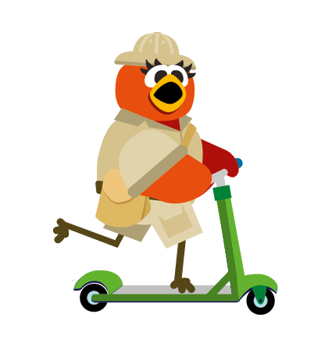
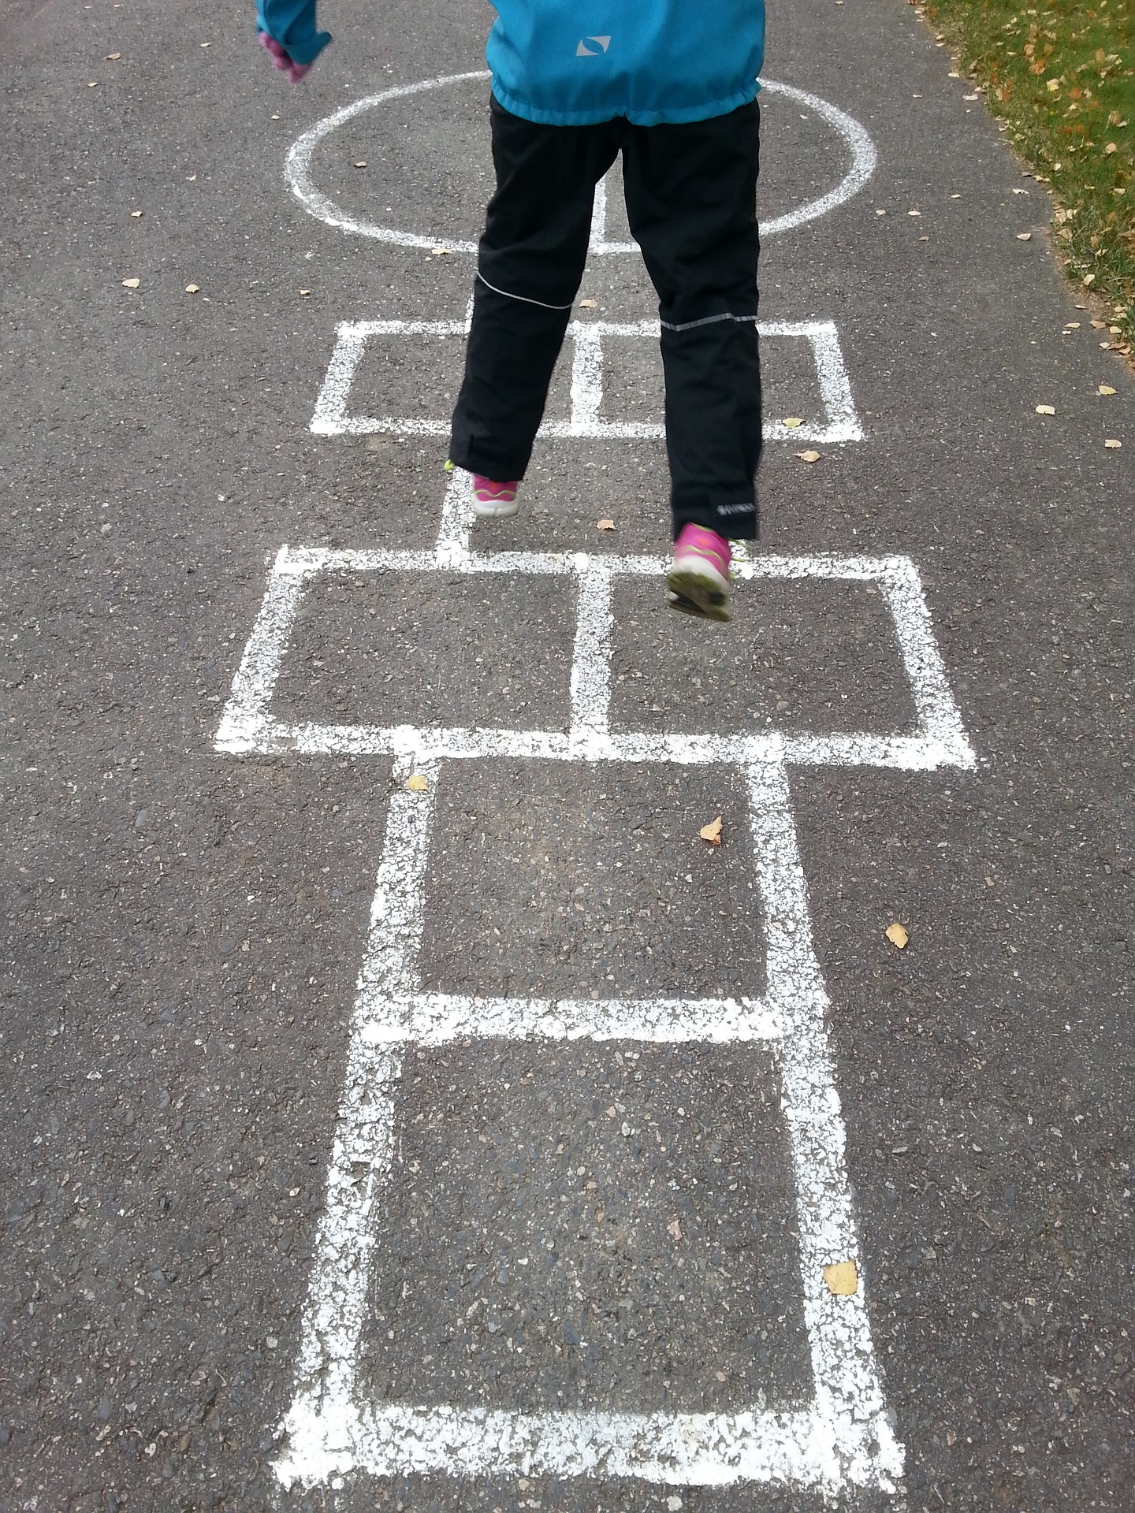
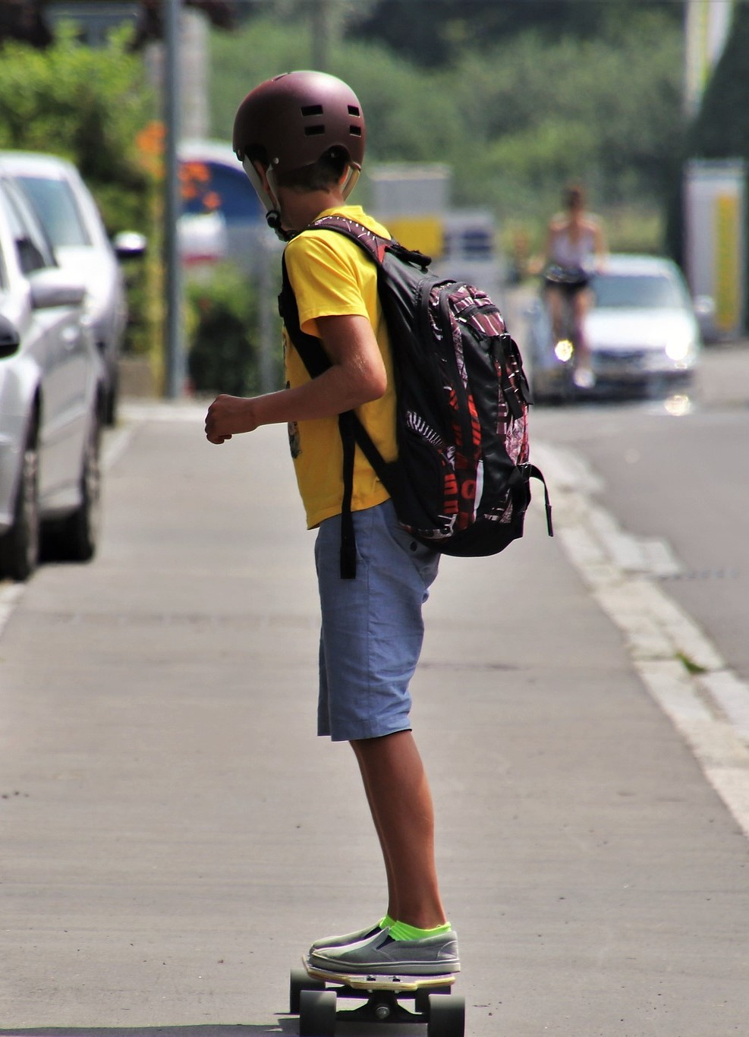
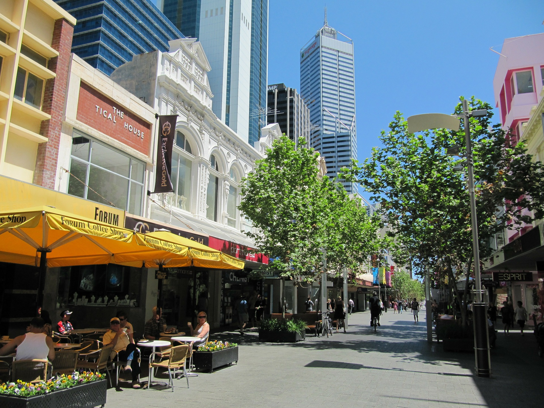
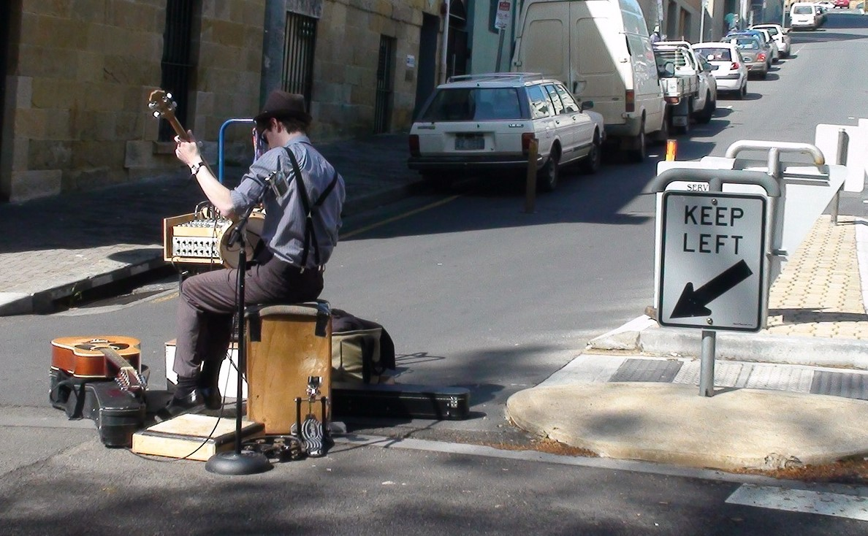
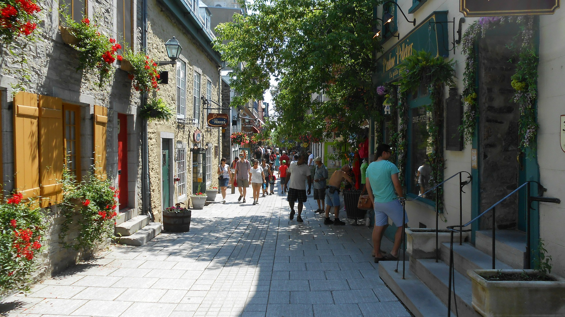
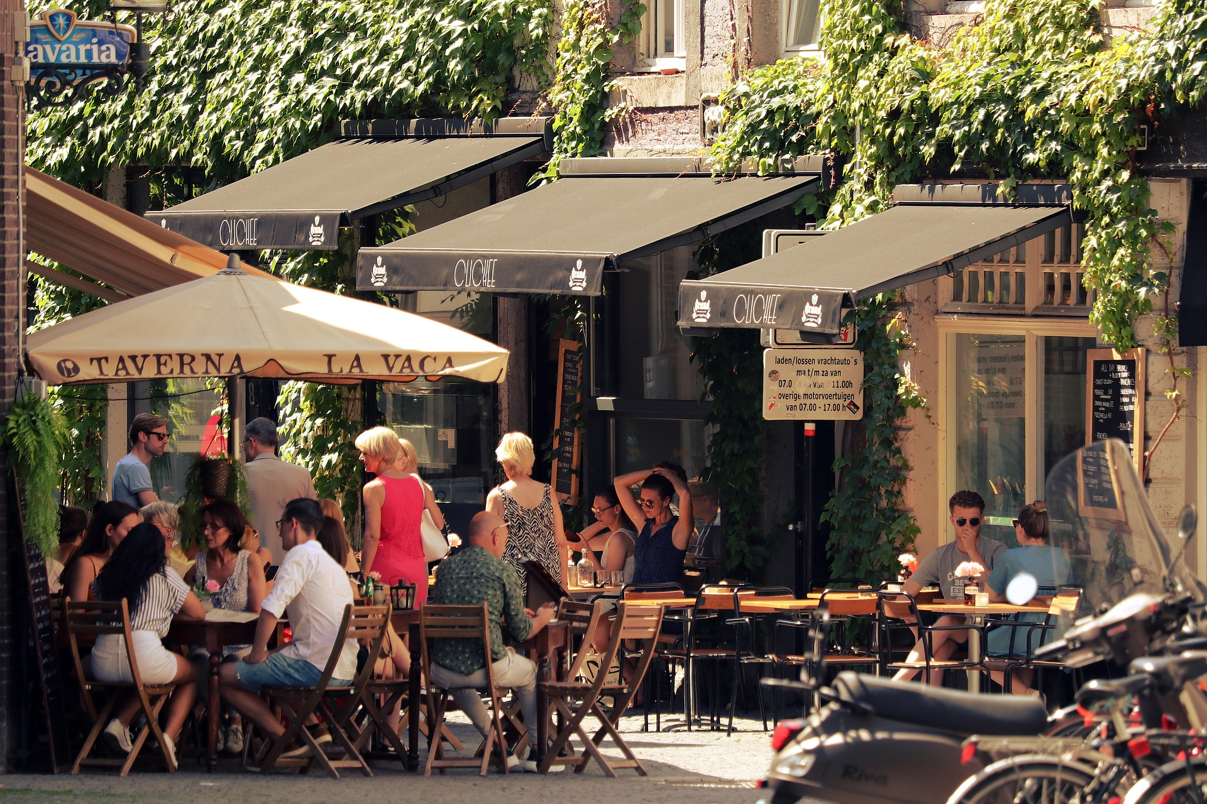
How can we reduce air pollution and make streets more people-friendly?
Notes:
What features can make streets more people-friendly and enjoyable?
Seating and cafes where people can meet and chat, trees for shade, play areas, cycle paths, flowers and plants to encourage wildlife.

Slide 14
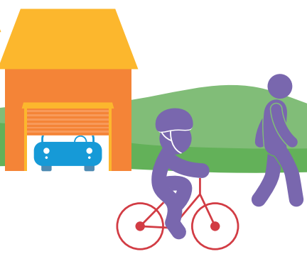
We need to persuade people to drive less.
Give your car the day off!
Notes:
Clean Air Day is a chance to raise awareness about the problems caused by air pollution and to encourage people to help to breathe cleaner air.
Let’s think of some reasons to persuade people to leave their cars at home.

Slide 15
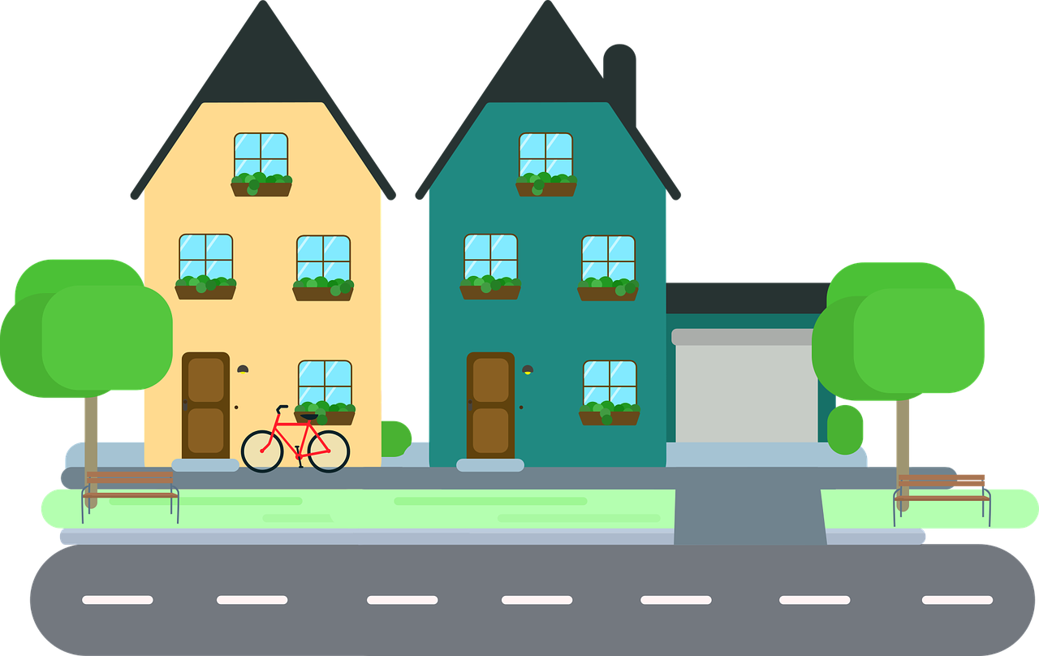
What have we learnt from the pandemic lockdowns?
We can change our behaviour!
Businesses and schools were shut and more people have had to work from home – less traffic.
Closed shops meant more online shopping from home.
As sports centres and gyms were closed, more people enjoyed walking and cycling for leisure.
Some streets were closed to cars and vans to allow for safe distancing.
Notes:
People have enjoyed quieter neighbourhoods and streets. Birdsong could be heard again!
How did the Government get their Covid-19 messages out to the general public?
What will happen when the lockdown is over? Will we start driving even more as we avoid public transport?

Slide 16
https://www.youtube.com/watch?v=SeS1Ho5wbJc

Slide 17
Here’s what you need to do:
On your own or with a team of no more than five pupils, plan a campaign to encourage people to leave cars at home whenever possible and make streets more people-friendly.
Decide who you would like to target with your campaign materials
e.g. pupils (pester power), parents, local residents, businesses, school staff.
2. To help you decide how to persuade people, talk to a few of your target
audience and find out for example:
what they like about strolling or cycling in quiet streets and
what they dislike about moving through busy roads,
about any advertisements or posters that they remember, and which persuaded them to try something new.
Notes:
How did the Government get their Covid-19 messages out to the general public?

Slide 18
Plan your campaign!
Use this information to think about the best way to encourage people to leave their cars at home and make streets more people-friendly and make at least three different types of campaign materials from the following list:
Write in a front-page article for your local newspaper or school newsletter
Draw a comic strip or simple flip cartoon
If you’re musical write a song or rap or poem
Use your artistic skills to draw a colourful poster
Design a T-shirt with an eye-catching slogan

Slide 19
Good luck!

